Slide 1
Employee Data Analysis using Excel
STUDENT NAME : Vijaya kumar. S
REGISTER NO : 312202982 /U/COM-G/22/39
DEPARTMENT : B-COM (GENERAL)
COLLEGE : ASAN MEMORIAL COLLEGE OF ARTS AND SCIENCE

Slide 2

PROJECT TITLE
Employee Performance Analysis using Excel

Slide 3


AGENDA:
Problem Statement
Project Overview
End Users
Our Solution and Proposition
Dataset Description
Modelling Approach
Results
Conclusion
3/21/2024 Annual Review

Slide 4

PROBLEM STATEMENT :
To solve the difficulties in an organisation.
To focus on the growth of the organistaion.
To analysis the performances of employees.
To motivate the low performers by giving
appreciation.
To appreciate the best performers by
giving increments, bonus and promotions.

Slide 5

PROJECT OVERVIEW :
.
Evaluating the performance of the employee’s job and their overall contribution to the company by considering the datas of the employee, like their Name, Employee ID’s, Gender,Work experience,Rating and their Work locations, In order to identify the trends and patterns of different categories of employees.

Slide 6
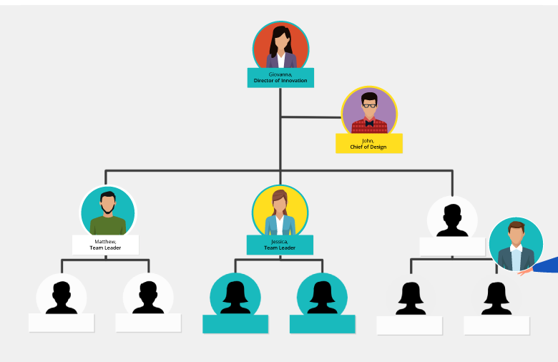

WHO ARE THE END USERS?
CEO
Directors
Manager
Foreman
Sales Executive
Sales Person
Workers and Employees

Slide 7

OUR SOLUTION AND ITS VALUE PROPOSITION
Conditional formatting - To find the missing values.
Filter - To remove the blank spaces between the data’s
Formula - To rate the employees performances through formulating.
Pivot Table - To produce a detail summary about the employees performance with various fields like Employees rating, Gender and Work locations.
Graph - To show a pictorial representation about the data.
Slicer - To change the view of chart through the help of slicer tool.

Slide 8
Data Set Description:
Employee ID
Name
Gender
Department
Salary
Start Date
FTE
Employee type
Work location
Current employee rating
performance level

Slide 9

THE "WOW" IN OUR SOLUTION:
Easy to understand through the pictorial view.
Straight view of the performances.
Ratings of employees in an understandable points.
3/21/2024 Annual Review
9

Slide 10

MODELLING:
Data collection:
Name
Emp ID
Feature collection:
Start date
FTE
Employee type
Data cleaning:
Gender
Current Employee Rating
10

Slide 11
.
Performance level using formula:
Low
Med
High
Very High
Conditional format:
Found the missing values
And Highlighted
Filter:
Select the missing blocks
Omitted the blank cell

Slide 12
figure: PIVOT TABLE
Pivot Table:
Summary of the data.
Like Employee type and performances.
Gender | (Multiple Items)
Count of Name | Column Labels
Row Labels | High | Low | Med | Very High | Grand Total
Fixed Term | 17 |  | 10 | 7 | 34
Permanent | 48 | 11 | 50 | 15 | 124
Temporary | 9 | 3 | 11 | 9 | 32
Grand Total | 74 | 14 | 71 | 31 | 190

Slide 13
fig: Graph
Graph:
Data visualisation.
Pictorial Representation.

Slide 14
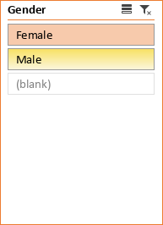
fig:Slicer chart
Slicer:
Data can be viewed in chart.
Can change the view of data types.

Slide 15
RESULTS:
Best performers among the various employee types.
15

Slide 16
.
Best Performances between the new comers and old employees.
Trend analysis of the organisations.
Drawbacks in the Performances.
Convinience of the employees for their work locations.
Analysation of profit through performances.

Slide 17
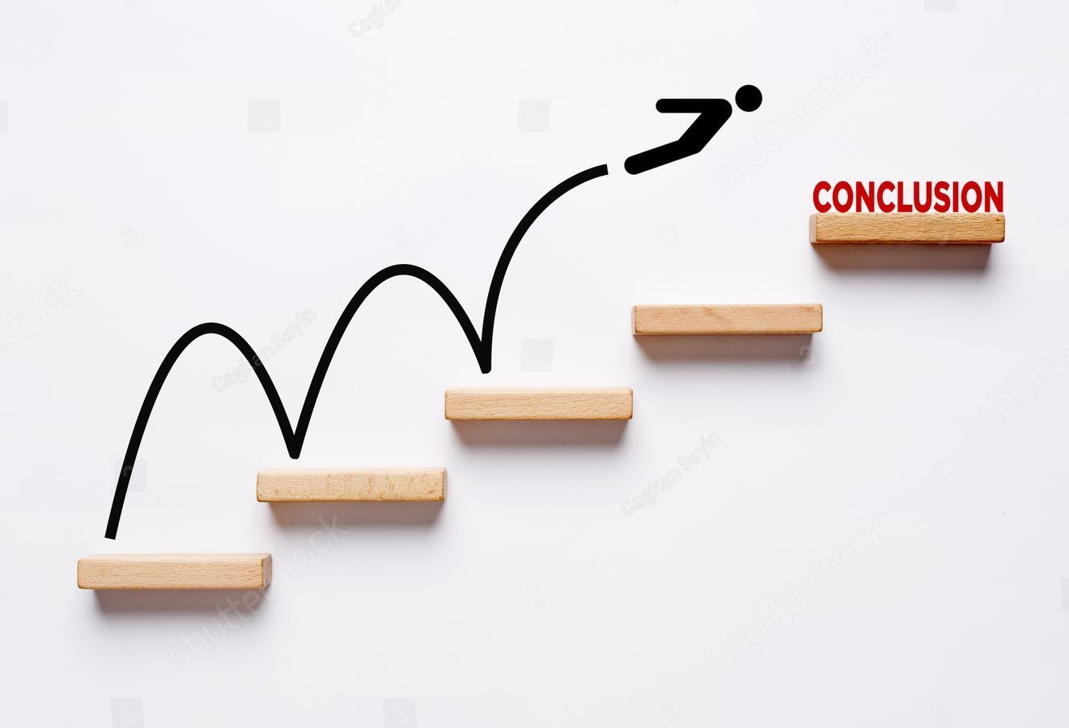
CONCLUSION:
Through this data analysis we can rectify the problems faced by the employees.
Appreciating the best employees by giving them the incentives, bonus and promotions.
Motivating the low level employees.
Analyzing the trend helps to improve the performing methods of the employees.
Allotment of working places and time periods of employees is uncomplicated.
Performances analysis helps to find the best way to the profit making business.

